Slide 1
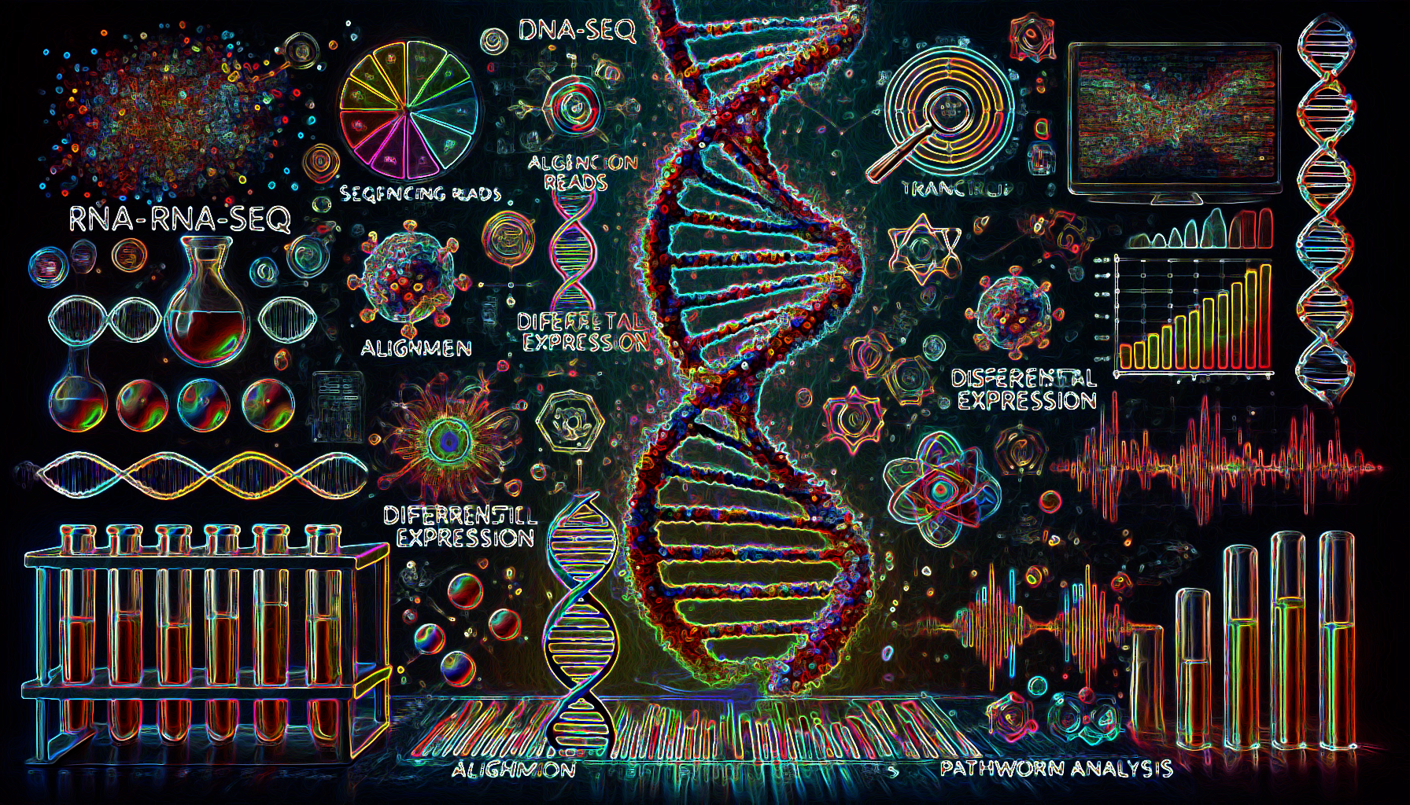
Module #5: RNA-Seq Analysis: From Raw Data to Biological Insights
Muhammad Elsadany
Department of Psychiatry
Michaelson Lab

Slide 2
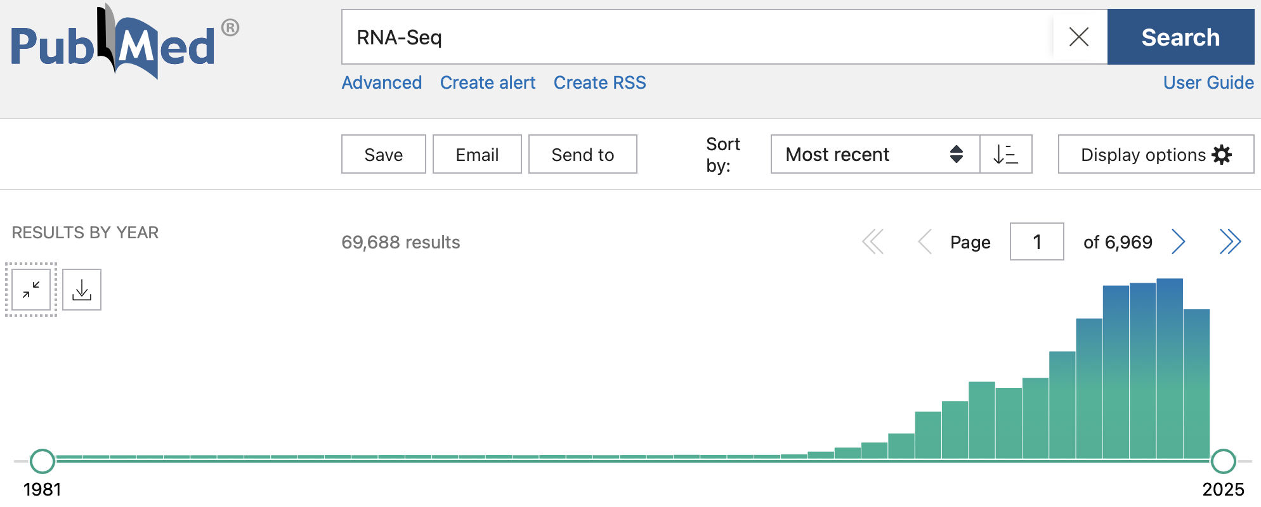
RNA-Seq
Captures the snapshot of RNA presence and quantity from a biological sample at a given moment.
Identifies differentially expressed genes (DEGs) under various conditions (e.g., healthy vs. diseased tissue)

Slide 3
RNA-Seq Workflow Overview
Experimental Design Replicates, sequencing depth
Sequencing Platforms (Illumina, PacBio, Oxford Nanopore)
Quality Control Raw data checks (FASTQ files)
Read Alignment/Mapping Mapping reads to reference genome
Quantification Counting reads per transcript/gene
Differential Expression Analysis Compare expression levels between conditions
Functional Enrichment Pathway analysis, gene ontology

Slide 4
RNA-Seq Workflow Overview
Experimental Design Replicates, sequencing depth
Sequencing Platforms (Illumina, PacBio, Oxford Nanopore)
Quality Control Raw data checks (FASTQ files)
Read Alignment/Mapping Mapping reads to reference genome
Quantification Counting reads per transcript/gene
Differential Expression Analysis Compare expression levels between conditions
Functional Enrichment Pathway analysis, gene ontology

Slide 5
RNA-Seq Workflow Overview
Experimental Design Replicates, sequencing depth
Sequencing Platforms (Illumina, PacBio, Oxford Nanopore)
Quality Control Raw data checks (FASTQ files)
Read Alignment/Mapping Mapping reads to reference genome
Quantification Counting reads per transcript/gene
Differential Expression Analysis Compare expression levels between conditions
Functional Enrichment Pathway analysis, gene ontology

Slide 6
Quality Control

Slide 7
 | Alignment

Slide 8
 |  | Quantification

Slide 9
 |  |  | Differential Expression

Slide 10
 |  |  |  | Functional Enrichment

Slide 11
Quality Control | Alignment | Quantification | Differential Expression | Functional Enrichment

Slide 12
Raw FASTQ
Trimmomatic

Slide 13
Tools and Websites
RNAseqChef:
https://www.jbc.org/article/S0021-9258(23)01838-0/fulltext#app-1
https://imeg-ku.shinyapps.io/RNAseqChef/
RaNA-Seq:
https://ranaseq.eu/analysis

Slide 14
Go to GEO, search for GSE179379
In that page, find the SRA accession number and copy it
Go to the SRA website and paste the accession number in the search box.
Select all 20 samples you see in the results
Click on “Send results to Run selector” hyperlink at the top.
You should see 20 files with a 12.55 Gb size
Select all 20 Runs and click on Galaxy in the computing column of the second table in that page.
You should be on galaxy server now

Slide 15
Wait until the SRA files are done being transferred to the server

